Slide 1
VB Script

Slide 2
What is VBScript?
Visual Basic Script (VBScript) is a subset of Microsoft Visual Basic used in World Wide Web XHTML documents to enhance the functionality of a Web page displayed in a Web browser.
Microsoft’s Internet Explorer Web browser contains a VBScript scripting engine (i.e., an interpreter) that executes VBScript code.
In this chapter, we introduce client-side VBScript for use in XHTML documents.
Because JavaScript has become the de facto client- side scripting language in industry, you are not likely to use client-side VBScript

Slide 3
Operators
VBScript is a case-insensitive language that provides arithmetic operators, logical operators,
concatenation operators, comparison operators and relational operators.
VBScript’s arithmetic operators are similar to the JavaScript arithmetic operators.
Two major differences are the division operator, \, which returns an integer result and the exponentiation operator, ^, which raises a value to a power.

Slide 4
Operators

Slide 5
Operators

Slide 6
Data Types
VBScript has only one data type—variant—that is capable of storing different types of data (e.g., strings, integers, floating-point numbers etc.).
VBScript interprets a variant in a manner that is suitable to the type of data it contains.
For example,
if a variant contains numeric information, it will be treated as a number;
if it contains string information, it will be treated as a string.

Slide 7
Control Structures

Slide 8
If statement

Slide 9
Select Case

Slide 10
Do While Loop
VBScript’s While/Wend repetition structure and Do While/Loop behave identically to JavaScript’s while repetition structure.
VBScript’s Do/Loop While structure behaves identically to JavaScript’s do/while repetition structure.

Slide 11
Do Until Loop

Slide 12
For Loop

Slide 13
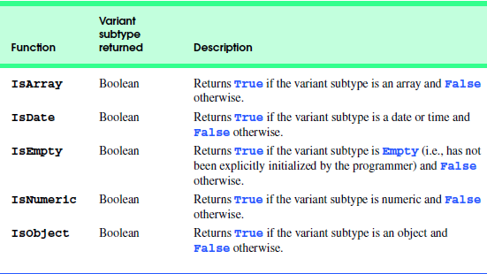
VBScript Functions

Slide 14
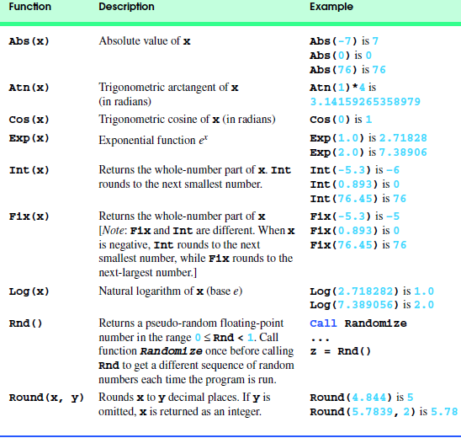
VBScript Functions

Slide 15
Using Variables
To declare a variable in a VBS script, you use the Dim statement.
Dim stands for dimension:
<SCRIPT LANGUAGE="VBS">
<!-- Option Explicit
Dim MyString
MyString="This is my string" --> </SCRIPT>
You can declare more than one variable at a time. Just use the Dim statement and put a comma between every new variable name:
Dim Name, Address, City, State, Zip

Slide 16
Procedures in Scripts
Procedures are the logical parts into which a program is divided.
The code inside a procedure is run when the procedure is called.
A procedure can be called with a Call statement in another procedure, or it can be triggered by an event such as a button click.
Events are triggered when messages are sent from the operating system to VBScript.
In graphical operating systems, such as Windows, the way that different applications interact with the operating system is by sending and receiving.

Slide 17
Sub Procedures & Function Procedures
There are two types of procedures in VBScript:
Sub procedures
and Function procedures.
Sub procedures are blocks of code that are wrapped in the Sub...End Sub keywords.
A Sub can take arguments and process them within the Sub procedure.
A Sub can call other procedures, but it can't return a value generated to the calling procedure directly.
A Function procedure works just like a Sub procedure.
It can take arguments and call other procedures.
Most importantly, Function procedures return a value to the calling procedure.

Slide 18
Example
Sub Btn1_OnClick
Dim Message, x x=100
Message="Sub Btn1_OnClick"
MsgBox Message, 0,"Procedure Result"
Message = "Sub MySub"
MySub(Message)
x = ReturnCount(x)
Message = "Function returned " + CStr(x) MsgBox Message, 0, "Procedure Result"
End Sub
Sub MySub(Msg)
MsgBox Msg, 0, "Procedure Result"
End Sub
Function ReturnCount(Num)
ReturnCount = Num + 1
End Function

Slide 19
Intrinsic Functions
VBScript provides two functions, InputBox and MsgBox, for interacting with the user.
Function InputBox displays a dialog in which the user can input data.
For example, the statement intValue = InputBox( "Enter an integer", "Input Box", , 1000, 1000 )
displays an input dialog (Fig. 24.15) containing the prompt ("Enter an integer") and the caption ("Input Box") at position (1000, 1000) on the screen.
VBScript coordinates are measured in units of twips (1440 twips equal 1 inch). Position (1000, 1000) is relative to the upper-left corner of the screen, which is position (0, 0).
On the screen, x coordinates increase from left to right and y coordinates increase from top to bottom.

Slide 20
Intrinsic Functions
When called, function MsgBox displays a message dialog
For example, the statement Call MsgBox( "VBScript is fun!", , "Results" )
displays a message dialog containing "VBScript is fun!" with "Results" in the title bar.
Although not used here, the optional argument allows the programmer to customize the MsgBox’s buttons (e.g., OK, Yes, etc.) and icon.

Slide 21
Events
Event | Description
onchange | Script runs when the element changes
onsubmit | Script runs when the form is submitted
onreset | Script runs when the form is reset
onblur | Script runs when the element loses focus
onfocus | Script runs when the element gets focus
onkeydown | Script runs when key is pressed
onkeypress | Script runs when key is pressed and released
onkeyup | Script runs when key is released

Slide 22
Events
onclick | Script runs when a mouse click
ondblclick | Script runs when a mouse double-click
onmousedown | Script runs when mouse button is pressed
onmousemove | Script runs when mouse pointer moves
onmouseout | Script runs when mouse pointer moves out of an element
onmouseover | Script runs when mouse pointer moves over an element
onmouseup | Script runs when mouse button is released

Slide 23
Example
<html>
<head>
<title>VB script demo</title>
<script type="text/vbscript">
sub btn1_OnClick()
dim a
a=frm1.txt1.value
Msgbox(a)
end sub
</script>
</head>
<body>
<form name="frm1">
Name<input type="text" name="txt1"/>
<br/><input type="button" name="btn1"
value="Click Me"/>
</form>
</body>
</html>

Slide 24
String Functions
Name | Description
LCase | Converts a specified string to lowercase; LCase(string)
Left | Returns a specified number of characters from the left side of a string; Left(string,length)
Len | Returns the number of characters in a string; Len(string)
LTrim | Removes spaces on the left side of a string; LTrim(string)
RTrim | Removes spaces on the right side of a string; RTrim(string)
Trim | Removes spaces on both the left and the right side of a string; Trim(string)
Mid | Returns a specified number of characters from a string; Mid(string,start[,length])
Right | Returns a specified number of characters from the right side of a string; Right(string,length)
Asc | Converts the first letter in a string to ANSI code; Asc(string)
Chr | Converts the specified ANSI code to a character; Chr(charcode)

Slide 25
Array
When a series of values are stored in a single variable, then it is known as array variable.
Array Declaration
Arrays are declared the same way a variable has been declared except that the declaration of an array variable uses parenthesis.
In the below example, the size of the array is mentioned in the brackets.
'Method 1 : Using Dim Dim arr1() 'Without Size
'Method 2 : Mentioning the Size Dim arr2(5) 'Declared with size of 5
Method 3 : using 'Array' Parameter Dim arr3 arr3 = Array("apple","Orange","Grapes")
Although, the Array size is indicated as 5, it can hold 6 values as array index starts from ZERO.
Array Index Cannot be Negative.
VBScript Arrays can store any type of variable in an array.
Hence, an array can store an integer, string or characters in a single array variable.

Slide 26
Assigning Values to an Array
The values are assigned to the array by specifying array index value against each one of the values to be assigned. It can be a string.
Dim arr(5)
arr(0) = "1" ‘Number as String
arr(1) = "VBScript" ‘String
arr(2) = 100 ‘Number
arr(3) = 2.45 ‘Decimal Number
arr(4) = #10/07/2013# 'Date
arr(5) = #12.45 PM# 'Time
document.write("Value stored in Array index 0 : " & arr(0) & "<br />")
document.write("Value stored in Array index 1 : " & arr(1) & "<br />")

Slide 27
Redim Statement
ReDim Statement is used to Declare dynamic-array variables and allocate or reallocate storage space.
ReDim [Preserve] varname(subscripts) [, varname(subscripts)]
Preserve - An Optional parameter used to preserve the data in an existing array when you change the size of the last dimension.
varname - A Required parameter, which denotes Name of the variable, which should follow the standard variable naming conventions.
subscripts - A Required parameter, which indicates the size of the array.
Dim a()
i=0
redim a(5)
a(0)="XYZ"
a(1)=41.25
a(2)=22
REDIM PRESERVE a(7)
For i=3 to 7
a(i)= i
Next

Slide 28
Array Methods
Lbound: The LBound Function returns the smallest subscript of the specified array. Hence, LBound of an array is ZERO.
Syntax: LBound(ArrayName)
Ubound: The UBound Function returns the Largest subscript of the specified array. Hence, this value corresponds to the size of the array.
Syntax: UBound(ArrayName)
Split: A Split Function returns an array that contains a specific number of values splitted based on a Delimiter.
Syntax:Split(expression[,delimiter[,count]])

Slide 29
Example of Split
<!DOCTYPE html>
<html>
<body>
<script language="vbscript" type="text/vbscript">
' Splitting based on delimiter comma '$'
a=Split("Red $ Blue $ Yellow","$")
b=ubound(a)
For i=0 to b
document.write("The value of array in " & i & " is :" & a(i)& "<br />")
Next
</script>
</body>
</html>

